Slide 1

7th Grade Math
Unit 6, Lesson 2 Currency Conversions Volume 1, pg. 241

Slide 2


Benchmark
MA.7.AR.3.3
Solve mathematical and real-world problems involving the conversion of units across different measurement systems.
volume 1, pg. 241

Slide 3
Integrated Mathematical Thinking and Reasoning Standards
MA.K12.MTR.7.1 Apply mathematics to real-world contexts.
volume 1, pg. 241

Slide 4

Learning Target
I can convert between two different forms of currency.
volume 1, pg. 241

Slide 5

Warm-Up
volume 2, pg. 241

Slide 6

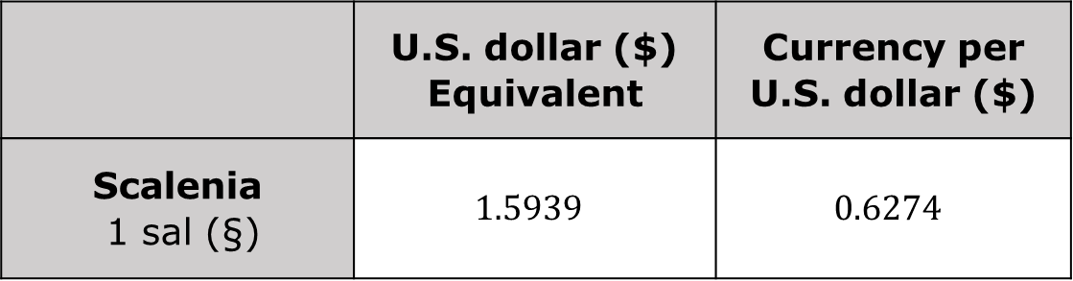
6.2.1 Warm-Up: Would you Rather?
Consider the exchange rates from currency in a Mathlandia country, Scalenia, compared to the United States (U.S.) dollar.
 | U.S. dollar ($) Equivalent | Currency per U.S. dollar ($)
Scalenia 1 sal (§) | $$1.5939$$ | $$0.6274$$
Would you rather have §$100$ or $\$100$? Explain your reasoning.
volume 1, pg. 241

Slide 7

Collaboration
volume 2, pg. 242

Slide 8

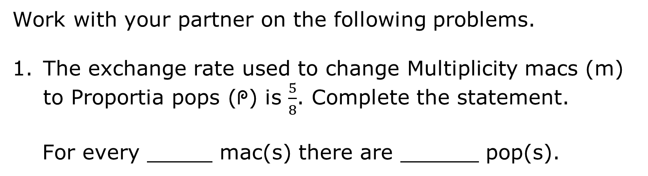
6.2.2 Collaboration: Reasoning and Sense Making
Work with your partner on the following problems.
The exchange rate used to change Multiplicity macs (m) to Proportia pops (ᖘ) is $\frac{5}{8}$. Complete the statement.
For every _____ mac(s) there are ______ pop(s).
volume 1, pg. 242

Slide 9
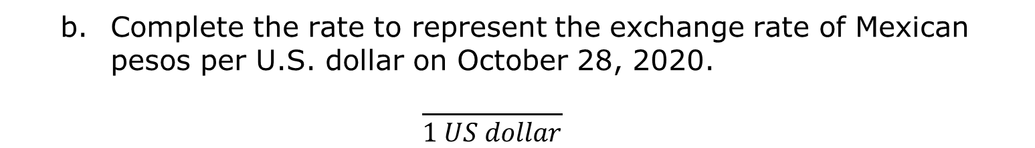
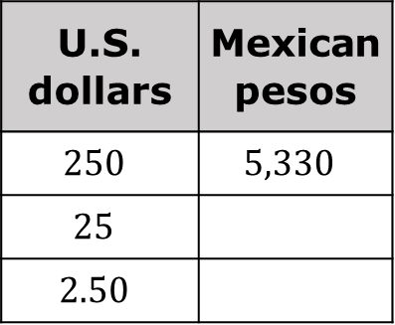
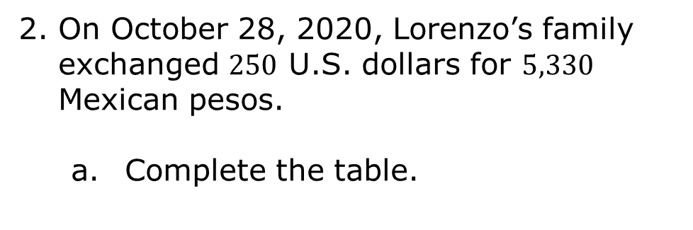
On October 28, 2020, Lorenzo’s family exchanged $250$ U.S. dollars for $5,330$ Mexican pesos.
Complete the table.
U.S. dollars | Mexican pesos
$$250$$ | $$5,330$$
$$25$$
$$2.50$$
Complete the rate to represent the exchange rate of Mexican pesos per U.S. dollar on October 28, 2020.
$$\frac{}{1 US dollar}$$
volume 1, pg. 242

Slide 10
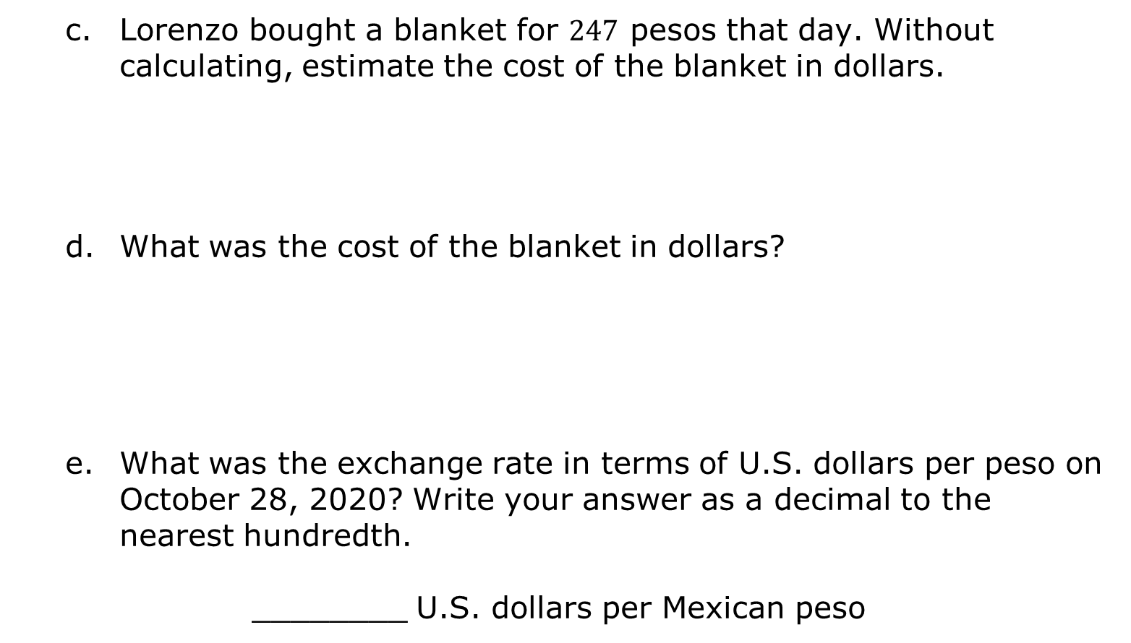
Lorenzo bought a blanket for $247$ pesos that day. Without calculating, estimate the cost of the blanket in dollars.
What was the cost of the blanket in dollars?
What was the exchange rate in terms of U.S. dollars per peso on October 28, 2020? Write your answer as a decimal to the nearest hundredth.
________ U.S. dollars per Mexican peso
volume 1, pg. 242

Slide 11

Guided Instruction
volume 1, pg. 243

Slide 12


6.2.3 Guided Instruction: Converting Currencies
An exchange rate is a ratio that compares two different currencies. An exchange rate can be written as a fraction, ratio, or decimal.
When the exchange rate is written as a unit rate, it shows the value of a certain currency for each one unit of the other currency.
Ratio tables, proportions, or other equations are useful when converting one currency to another.
volume 1, pg. 243

Slide 13
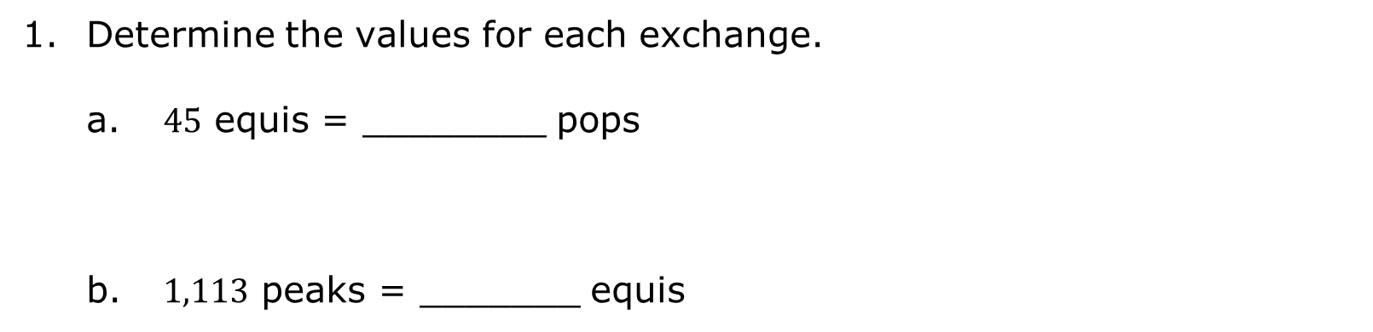
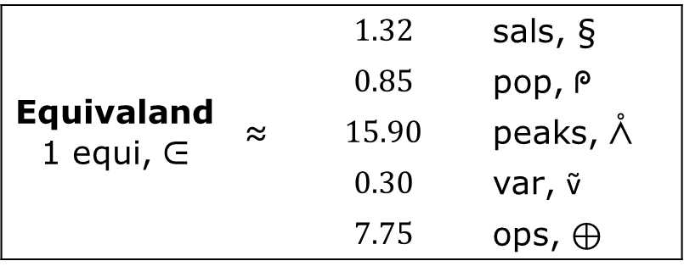
Recall the exchange rates from the Mathlandia Exploration.
Equivaland 1 equi, ᕮ | ≈ | $$1.32$$ | sals, §
 |  | $$0.85$$ | pop, ᖘ
 |  | $$15.90$$ | peaks, ᐰ
 |  | $$0.30$$ | var, ṽ
 |  | $$7.75$$ | ops, ⊕
Determine the values for each exchange.
$45$ equis = ________ pops
$1,113$ peaks = _______ equis
volume 1, pg. 243

Slide 14

Emma travels to Scalenia from Equivaland. She exchanges $200$ equis. How much does she receive in sals?
Emma purchases these items while in Scalenia. What is the cost of each item in equis, ᕮ?
A necklace for $§64.35$
A scarf for $§11.22$
volume 1, pg. 243

Slide 15

Guided Practice
volume 1, pg. 244

Slide 16

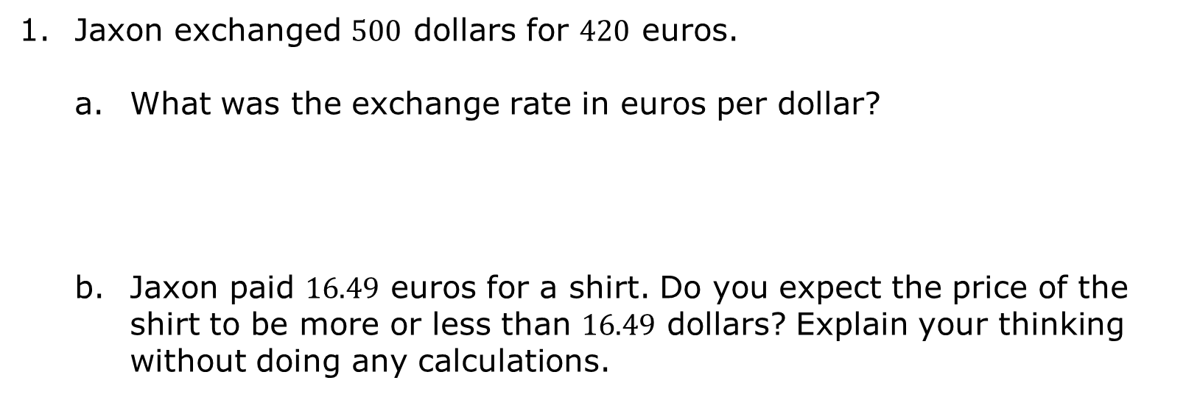
6.2.4 Guided Practice: Converting Currencies
Jaxon exchanged $500$ dollars for $420$ euros.
What was the exchange rate in euros per dollar?
Jaxon paid $16.49$ euros for a shirt. Do you expect the price of the shirt to be more or less than $16.49$ dollars? Explain your thinking without doing any calculations.
volume 1, pg. 244

Slide 17

What is the price of the shirt in dollars?
Keisha travels from Proportia to Variableya. The currency exchange rate is $1$ pop = $0.35$ var. Keisha exchanges $120$ pops. How much does she receive in vars?
volume 1, pg. 244

Slide 18

Your Turn
volume 1, pg. 244

Slide 19

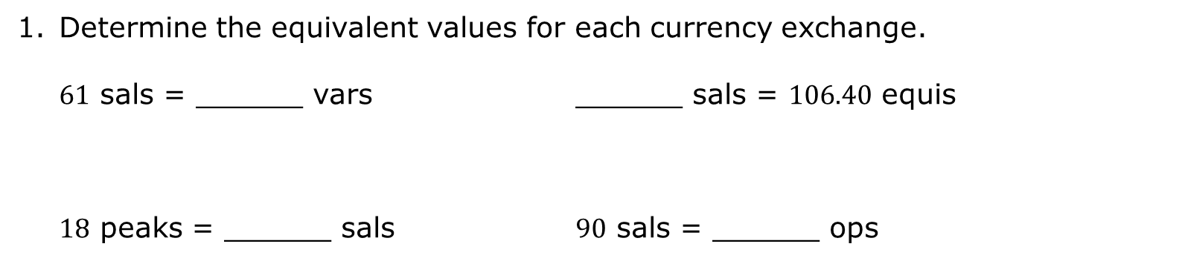
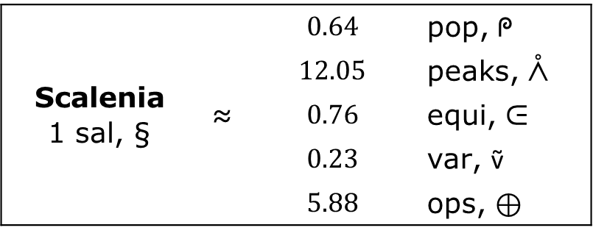
6.2.5 Your Turn!
Recall the exchange rates from the Mathlandia Exploration.
Scalenia 1 sal, § | ≈ | $$0.64$$ | pop, ᖘ
 |  | $$12.05$$ | peaks, ᐰ
 |  | $$0.76$$ | equi, ᕮ
 |  | $$0.23$$ | var, ṽ
 |  | $$5.88$$ | ops, ⊕
Determine the equivalent values for each currency exchange.
$61$ sals = ______ vars ______ sals = $106.40$ equis
$18$ peaks = ______ sals $90$ sals = ______ ops
volume 1, pg. 244

Slide 20

Logan lives in Equivaland and wants to take his family on vacation.
The exchange rate is $1$ equi (ᕮ) = $7.75$ ops (⊕).
Logan has saved up $400$ equis for the trip. Aunt Emma, from Prismopolis, sent $1,200$ peaks to help pay for the trip. The exchange rate is $1$ equi = $15.9$ peaks.
With Aunt Emma’s gift, how much does Logan have available for the trip in equis? Round to the nearest hundredth.
volume 1, pg. 244

Slide 21

Wrap-Up
volume 1, pg. 245

Slide 22
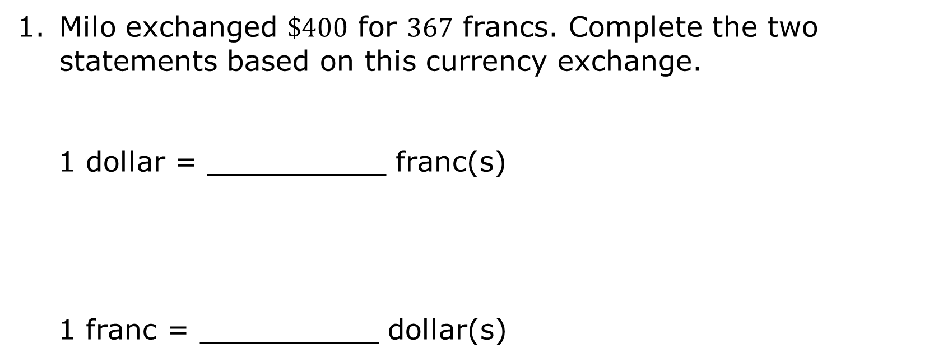
6.2.6 Wrap-Up: Ticket Out the Door
Milo exchanged $\$400$ for $367$ francs. Complete the two statements based on this currency exchange.
1 dollar = __________ franc(s)
1 franc = __________ dollar(s)
volume 1, pg. 245

Slide 23
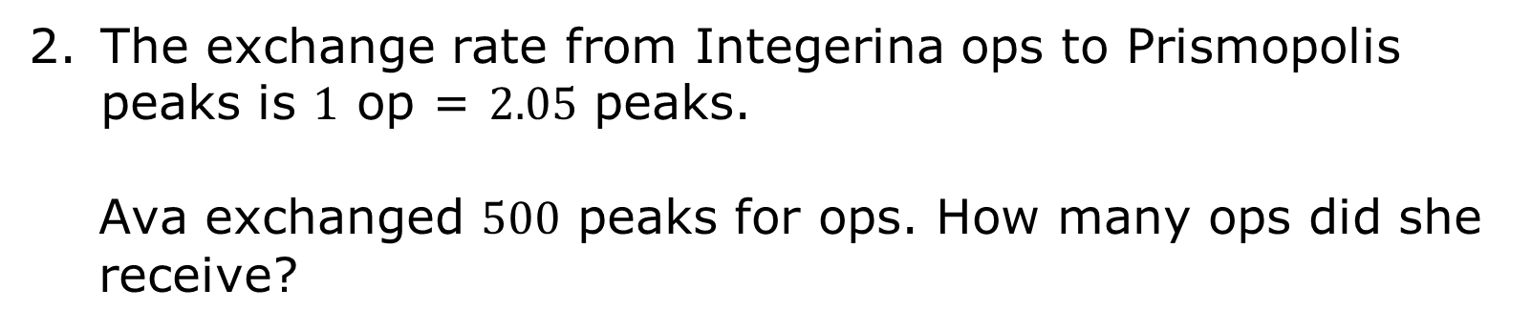
The exchange rate from Integerina ops to Prismopolis peaks is $1$ op = $2.05$ peaks.
Ava exchanged $500$ peaks for ops. How many ops did she receive?
volume 1, pg. 245

